Slide 1
Unit-III Dynamic Programming
CS-402 ADA

Slide 2
What is Dynamic Programming?
The dynamic programming algorithm tries to find the shortest way to a solution when solving a problem. It does this by going from the top down or the bottom up. The top-down method solves equations by breaking them into smaller ones and reusing the answers when needed. The bottom-up approach solves equations by breaking them up into smaller ones, then tries to solve the equation with the smallest mathematical value, and then works its way up to the equation with the biggest value.

Slide 3
Example
To understand Dynamic Programming more clearly, let us look at an example.
Suppose we want to reconstruct the Fibonacci Series. It is a series, which starts with 0 and 1, and each consecutive term is the sum of the previous two terms in the series.
So, the first few terms of the Fibonacci Series are: 0, 1, 1, 2, 3, 5, 8, and so on. It is very clear that to calculate each term after the first two terms, we will need the previous two terms of the series.

Slide 4
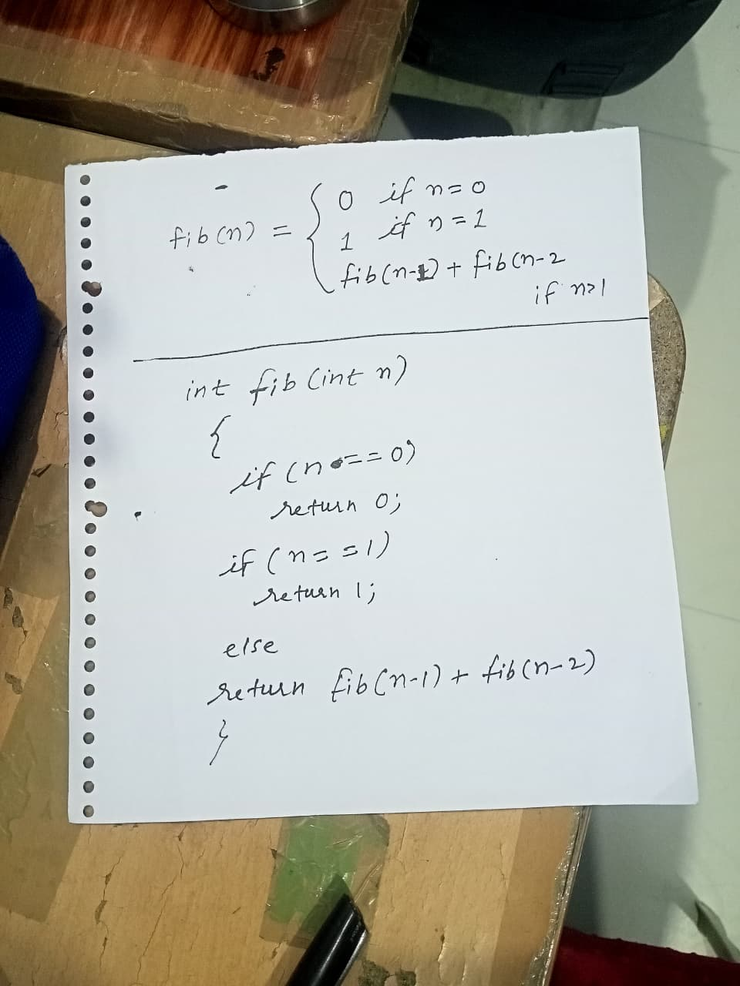
Example continue.…
Let's try to solve this problem using Recursion. The nth term can be calculated by adding its previous two terms. The base cases for the recursion will be the first two terms of the series which are 0 and 1. Hence, the recursive solution would be:
T(n) = O(2^n)

Slide 5
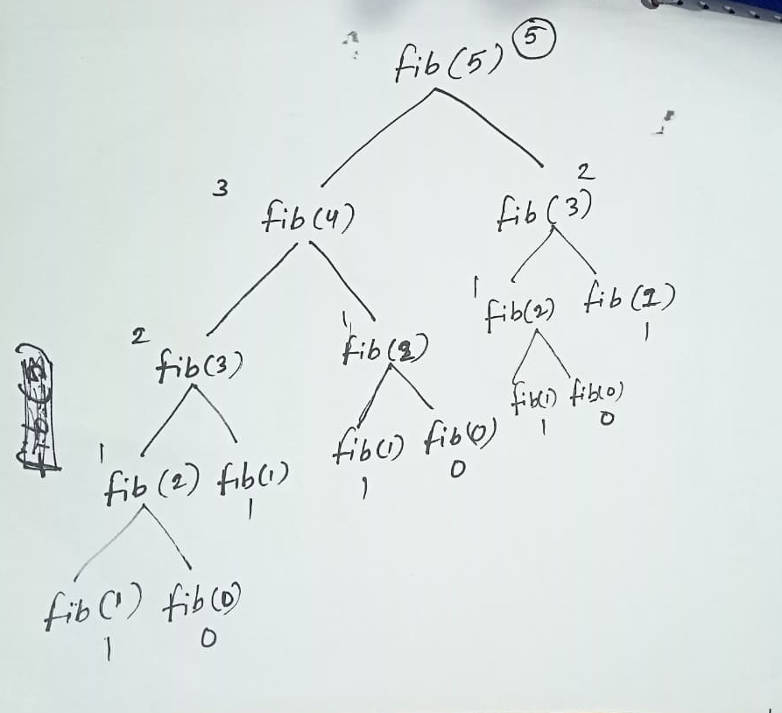
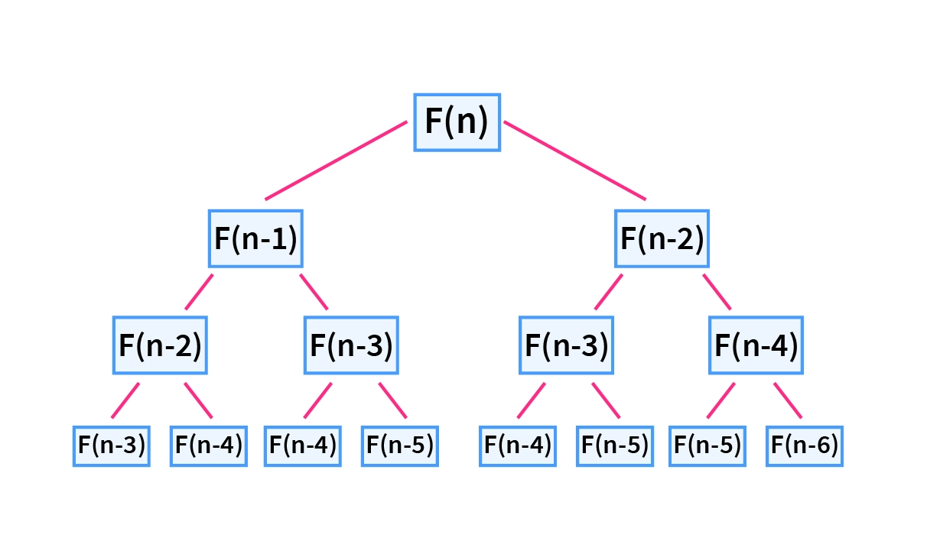
Example continue.…
recursion tree for the Fibonacci sequence.

